Slide 1


Slide 2


Team Members
Ashkan Aminian
Namratha Channabasavaiah
Sidheswar Venkatachalapathi

Slide 3
What we sell?
Mission Statement: “ To promote a healthy - vegan lifestyle through the use of high quality organic, non-GMO ingredients and give our customers the best foodgasm of their life. OH YEAH! ”
Vision statement: “ VeganHub desires to be the benchmark of the healthy food industry ”

Slide 4
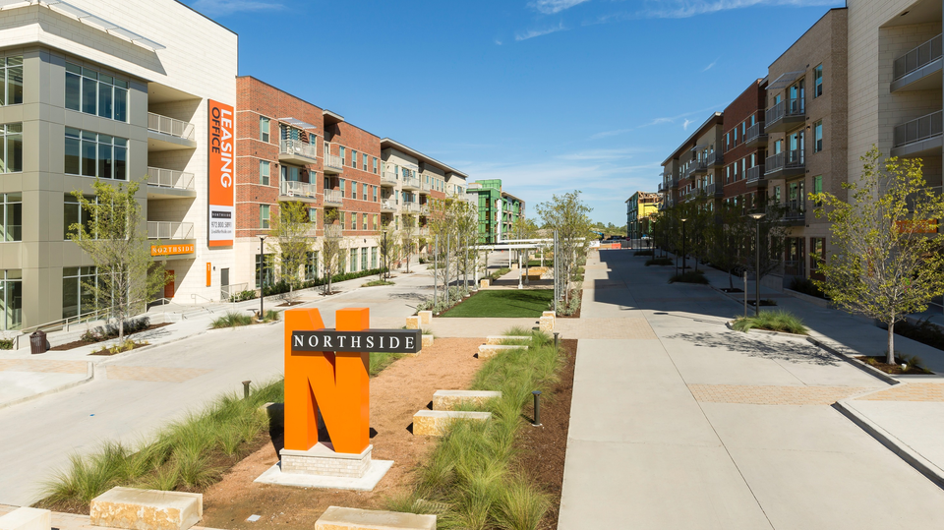
Where are we located?

Slide 5















Competitors
On-Campus Off-Campus

Slide 6
Marketing Objectives
Build brand awareness
Customer satisfaction and loyalty
Increase sales and profit
Target new customers
Launch new products or services

Slide 7

Target Market
Vegans
Health conscious people
UT Dallas students
Working professionals

Slide 8
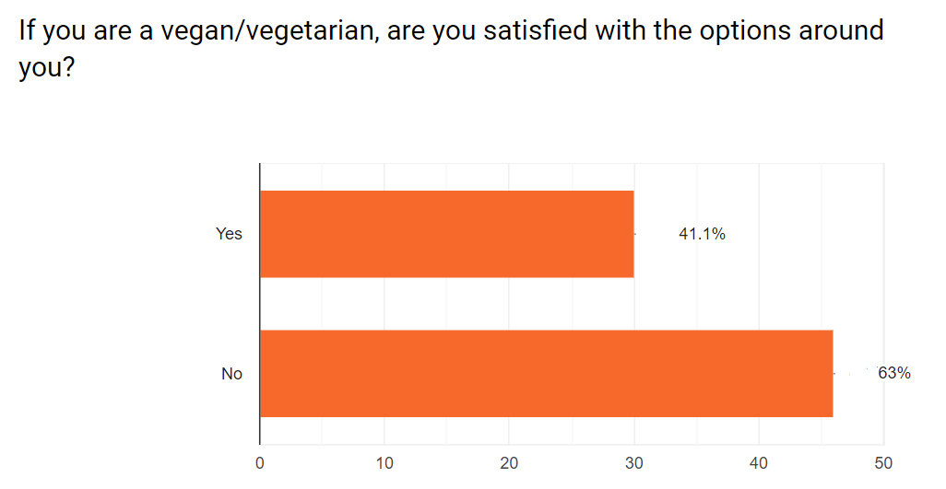
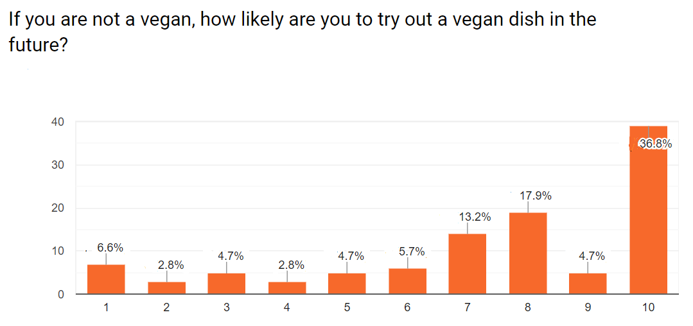
Target Market - Vegans

Slide 9
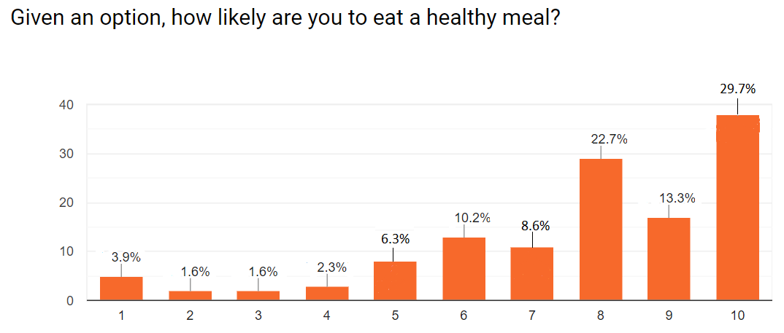
Target Market - Health Conscious People

Slide 10
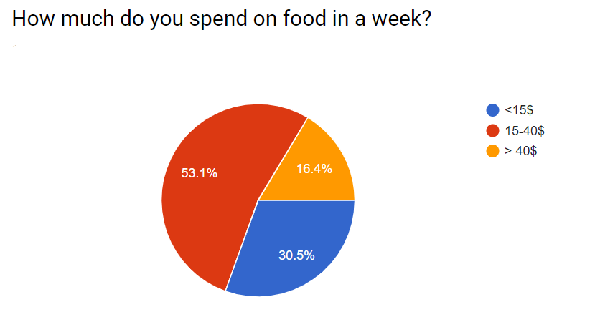
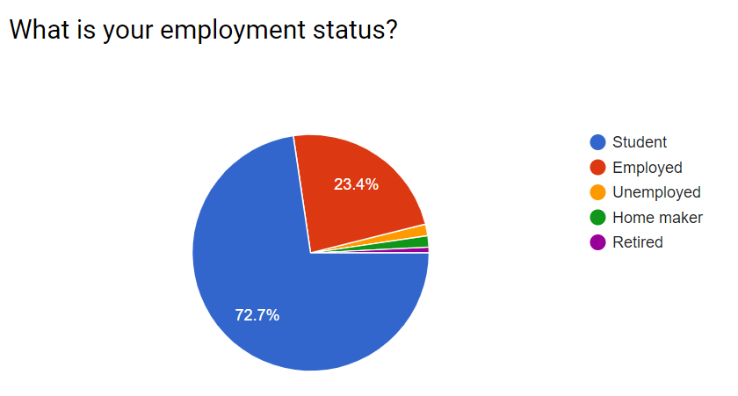
Target Market – Students and Professionals

Slide 11

Promotions
New businesses in the restaurant industry are prone to have a 60% failure rate.
GOAL : Apply pull strategy to bring customer base to us.

Slide 12


GO SOCIAL!

Slide 13


BRING ON THE CONTESTS!
#20VeganPushupsChallenge
Consumer Awareness

Slide 14

WEBSITES AND BLOGS
A Pen is mightier than a sword!
It’s fun when you are involved.
Seasonal promo codes and offers.

Slide 15

ENCOURAGE PHOTO-FRIENDLY ENVIRONMENT

Slide 16

REACH OUT TO SOCIAL MEDIA BLOGGERS
Their credibility and trust on our brand will influence the mass in trying VeganHub as their choice for vegan and healthy food.

Slide 17




PARTNERSHIPS WITH FITNESS CENTERS

Slide 18
Financial Projections
Overhead Expenses | Cost Per Month
Rent | 1500$
Insurance | 300$
Permits and License | 150$ (Per annum)
Appliances | 1000-1500$ (One-time expense)
Credit Card Processing fees | 500$
Promotion Expenses | 500$ - 1000$
Wages | 8,640$
Administrative expenses | 150$ - 500$
Loan Interest | 292$ (50,000$ with 7% APR)
Total Cost per month | 11035$
Food price = Raw material used + Overhead cost per food + Profit per meal
A profitable restaurant runs with a net margin of 20 to 25% on every sale, we are focusing on net margin around 10 to 15% inside the campus and 30-35% off campus.
Spinach guacamole comes around 4.62$ before adding 40% overhead expense. After adding overhead expense, the cost of appetizer is 6.468$ and adding 15% profit margin to the appetizer makes it 7.4382$. With 8.25% tax the price will come up to 8.045$.
Our food price will vary between 7$- 12$ which students are ready to pay for healthy food.

Slide 19
Financial Projections (Contd.)
TOTAL UNITS SOLD PER MONTH
MONTH | UNITS SOLD
August - 2019 | 700 - 800
September - 2019 | 1600 – 2000
October - 2019 | 2000 – 2100
November - 2019 | 2000 -2100
December - 2019 | 700 – 1000
January – 2020 | 700 – 1800
February- 2020 | 2000 – 3000
March – 2020 | 2000 – 3500
April – 2020 | 2000 – 2200
May - 2020 | 2000 –2200
MONTH | SALES
August - 2019 | $5,600
September - 2019 | $17,000
October - 2019 | $17,850
November - 2019 | $15,300
December - 2019 | $15,300
January – 2020 | $25,500
February- 2020 | $29,750
March – 2020 | $29,750
April – 2020 | $18,700
May - 2020 | $18,700

Slide 20
Financial Projections (Contd.)
MONTH | COST OF GOODS SOLD (including overhead expenses)
August - 2019 | $5,176
September - 2019 | $12,960
October - 2019 | $13,620
November - 2019 | $6,468
December - 2019 | $6,468
January – 2020 | $11,642
February- 2020 | $13,582
March – 2020 | $22,638
April – 2020 | $14,229
May - 2020 | $14,229

Slide 21
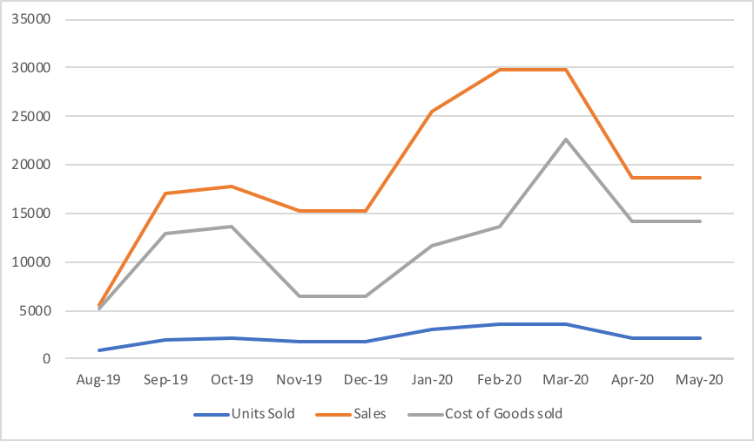
Financial Projections (Contd.)

Slide 22
Financial Projections (Contd.)
MONTH | GROSS PROFIT
August - 2019 | $424
September - 2019 | $4,040
October - 2019 | $4,230
November - 2019 | $8,832
December - 2019 | $8,832
January – 2020 | $13,858
February- 2020 | $16,168
March – 2020 | $7,112
April – 2020 | $4,471
May - 2020 | $4,471
Gross Profit = Sales – Cost of Goods sold

Slide 23
Financial Projections (Contd.)
MONTH | NET PROFIT
August - 2019 | $389.02
September - 2019 | $3706.7
October - 2019 | $3881.025
November - 2019 | $8103.36
December - 2019 | $8103.36
January – 2020 | $12714.715
February- 2020 | $14834.14
March – 2020 | $6525.26
April – 2020 | $4102.1425
May - 2020 | $4102.1425
Total | $66461.865
Net Profit = Gross Profit – EBIT(8.25% on Gross profit)

Slide 24
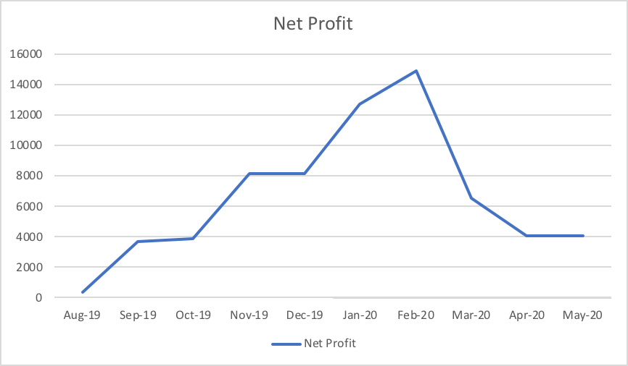
Financial Projections (Contd.)

